Slide 1
SENSOR KIT
Problem Statement:
To interface the different types of sensors and learning the different types of communication protocols.
SENSORS
BASICS OF BIT MANIPULATION
LED BLINKING AND DEBOUNCING
IR SENSOR
ULTRASONIC SENSOR
MPU 6050
COMMUNICATION PROTOCOLS
UART
I2C
SPI

Slide 2
Team Members:
1)Shubham Patil
2)Dhruv Patel
3)Arjun Parmar
4)Siddharth Reddy

Slide 3
INTERFACING LEDs
BLINKING & TOGGLING
BUTTON DEBOUNCING

Slide 4
BLINKING
START
INITIALIZE PIN TO OUTPUT
WHILE(1)
XOR PIN
DELAY

Slide 5
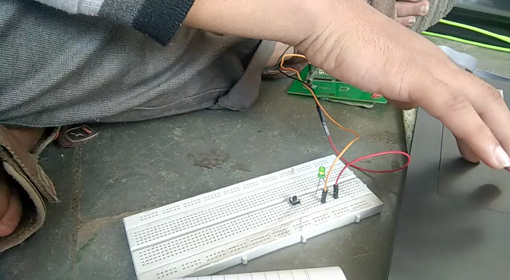

Slide 6
BUTTON DEBOUNCING
START
SET 2 PINS AS O/P & 1 PIN AS I/P
INITIALIZE I=0
WHILE(1)
NO
BUTTON IS PRESSED
I=0
YES
I=0
NO
YES
XOR BOTH LEDS & I=1

Slide 7
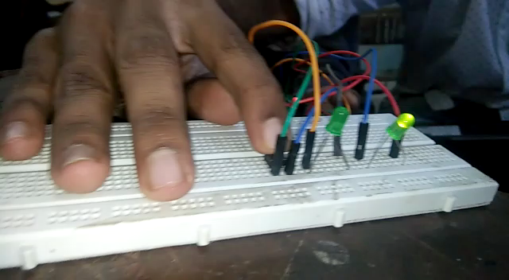

Slide 8
IR sensor (INFRARED RAY SENSOR)

Slide 9
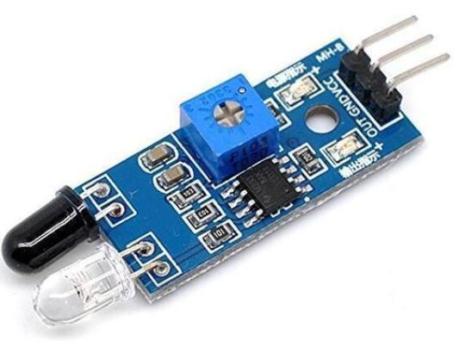
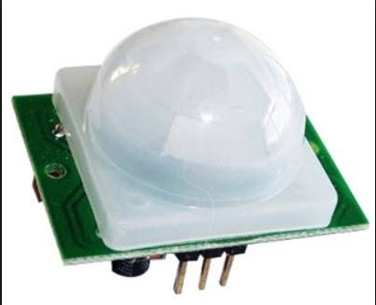
WHAT IS IR SENSOR?
An infrared sensor is an electronic device, that emits in order to sense some aspects of the surroundings.
Active IR
Passive IR(PIR)
The wavelengths of these regions and their applications are shown below.
Near infrared region — 700 nm to 1400 nm — IR sensors, fiber optic
Mid infrared region — 1400 nm to 3000 nm — Heat sensing
Far infrared region — 3000 nm to 1 mm — Thermal imaging

Slide 10
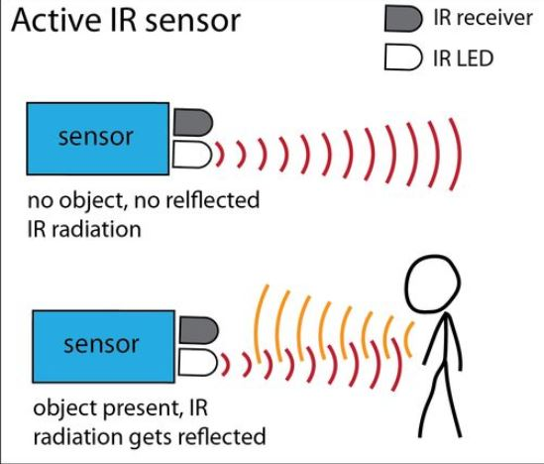
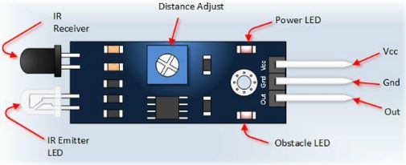
HOW IR SENSOR WORKS?
Basically consists of four parts
1) Transmitter(Light emitting diode transmits IR rays).
2) Receiver(Photo diode converts Reflected IR rays to current).
3)Comparator Circuit ( operational amplifier (op-amp)).
4)VCC,GND and OUT.

Slide 11
IR SENSOR
SWITCHING LED’S THROUGH IR SENSOR
Vcc Out Gnd
Atmega 128
OUT PIN is HIGH
OUT PIN
Is LOW
LED 1ON
LED 2 ON

Slide 12
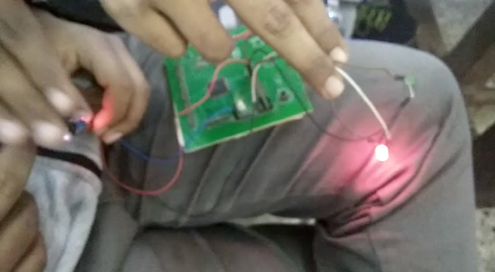

Slide 13
What is uart?
A universal asynchronous receiver-transmitter is a computer hardware device for asynchronous serial communication in which the data format and transmission speeds are configurable.
A UART is usually an individual (or part of an) integrated circuit (IC) used for serial communications over a computer or peripheral device serial port.

Slide 14
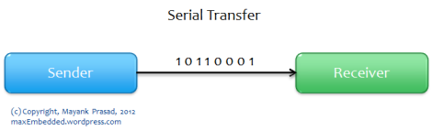
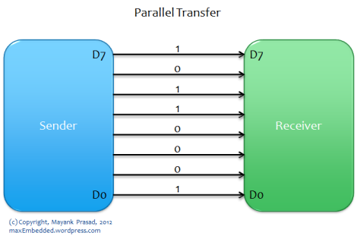
Serial communication is the process of sending/receiving data in one bit at a time.
It is like you are firing bullets from a machine gun to a target… that’s one bullet at a time!
Parallel communication is the process of sending/receiving multiple data bits at a time through parallel channels.
It is like you are firing using a shotgun to a target – where multiple bullets are fired from the same gun at a time! ;)

Slide 15
HOW UART WORKS ?
START BIT
initialize uart
SET DATA BIT
set the data bit size
PARITY BIT
check error in the data
STOP BIT
give signal to end the transmission of data packet

Slide 16
ADVANTAGES
Only use two wires
No clock signal
Has parity bit
DISADVANTAGES
Size of data frame is max 9 bits
No multiple Master-Slave Configuration

Slide 17
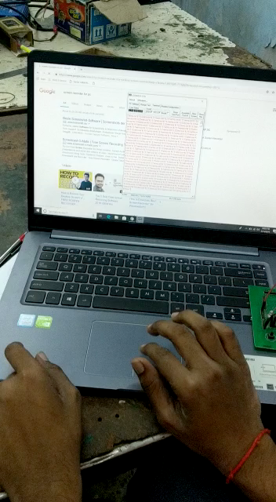

Slide 18
Distance measurement using Ultrasonic sensor hc-sr04

Slide 19


Slide 20
START
TRANSMIT THE SIGNAL
TIMER START
IF ECHO IS RECEIVED?
NO
WAIT TILL EXTREME TIME
YES
IF ECHO IS RECEIVED?
INTERRUPT FIRED
CAPTURE THE TIME
DISTANCE = 341*(TIME)/2
TIMER STOP
YES
NO

Slide 21
specifications
HC-SR04 Sensor Features
Operating voltage:+5V
Theoretical Measuring Distance: 2cm to 450cm
Practical Measuring Distance: 2cm to 80cm
Accuracy: 3mm
Measuring angle covered: <15°
Operating Current: <15mA
Operating Frequency: 40Hz

Slide 22
Twi (TWO WIRE SERIAL INTERFACE)
WHAT IS TWI?
TWI ALSO KNOWN AS Inter-integrated Circuit (I²C) COMMUNICATION Protocol is a protocol intended to allow multiple “slave” digital integrated circuits (“chips”) to communicate with one or more “master” chips. Like Asynchronous Serial Interfaces (such as RS-232 or UARTs), it only requires two signal wires to exchange information.

Slide 23
WHY TO USE TWI ?
Since serial ports are asynchronous (no clock data is transmitted) in UART, devices using them must agree ahead of time on a data rate. The two devices must also have clocks that are close to the same rate, and will remain so–excessive differences between clock rates on either end will cause garbled data.
Data rate is an issue. While there is no theoretical limit to asynchronous serial communications, most UART devices only support a certain set of fixed baud rates, and the highest of these is usually around 230400 bits per second.
Sometimes TWI is chosen over SPI because of its simplicity in hardware. In TWI only two pins are used SDA and SCL while in SPI 6 pins are used.

Slide 24
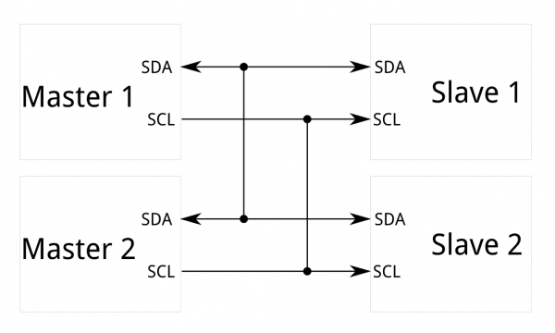
I²C requires a mere two wires, like asynchronous serial, but those two wires can support up to 128 slave devices. Also, unlike SPI, I²C can support a multi-master system, allowing more than one master to communicate with all devices on the bus (although the master devices can’t talk to each other over the bus and must take turns using the bus lines).

Slide 25
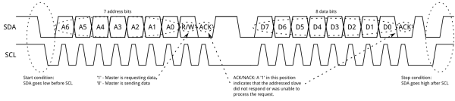
How to use twi?
Data rates fall between asynchronous serial and SPI; most I²C devices can communicate at 100kHz or 400kHz. There is some overhead with I²C; for every 8 bits of data to be sent, one extra bit of meta data (the “ACK/NACK” bit) must be transmitted.
Basically there are two pins used for TWI . SDA(Serial Data)pin and SCK(Serial Clock)pin.
SDA pin transmits data from to master to slave or slave to master.
SCK PIN is clock pin which is in a synchronous mode that make sure that data is transmitted in

Slide 26
TWI START CONDITION
SENDING ADDRESS FRAMES
TWI STOP CONDITION
TRANSMITTING DATA FRAMES

Slide 27
START
INITIALIZE TWI
SENDING DATA ADDRESS
SETTING X, Y, Z AXES REFERENCE FREQUENCY
CONFIGURE GYROSCOPE & ACCELEROMETER
ENABLE INTERRUPT FOR INITIALIZING TWI
REINITIALIZING TWI

Slide 28
mpu6050
(Six-Axis (Gyro + Accelerometer) MEMS Motion Tracking Devices)

Slide 29
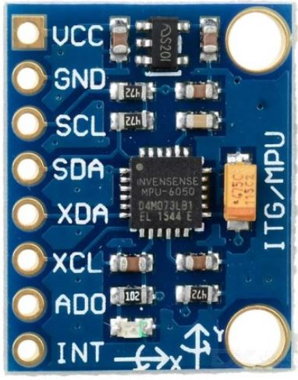
WHAT IS MPU6050
An inertial measurement unit (IMU) is an electronic device that measures and reports a body's specific force, angular rate, and sometimes the magnetic field surroundings the body, using a combination of accelerometers and gyroscopes, sometimes also magnetometers.
The MPU 6050 is a 6 DOF (Degrees of Freedom) or a six axis IMU sensor, which means that it gives six values as output. Three values from the accelerometer and three from the gyroscope.
The MPU 6050 is a sensor based on MEMS (Micro Electro Mechanical Systems) technology. Both the accelerometer and the gyroscope is embedded inside a single chip.
This chip uses I2C (Inter Integrated Circuit) protocol for communication.

Slide 30
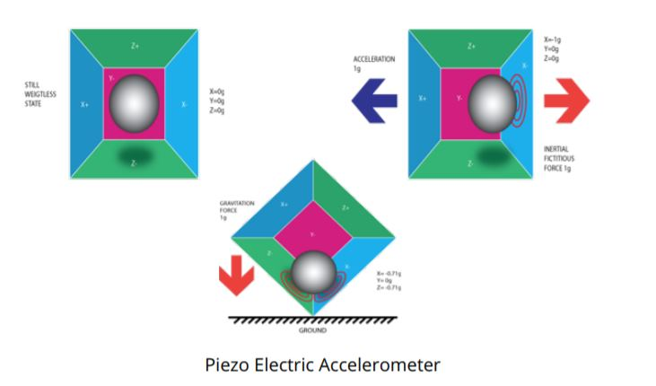
ACCELEROMETER
An accelerometer is an electromechanical
device used to measure acceleration forces.
Such forces may be static,
like the continuous force of gravity
or, as is the case with many
mobile devices, dynamic
to sense movement or vibrations.
An accelerometer works on the principle of piezo electric effect.
Imagine a cuboidal box, having a small ball inside it, like in the picture above. The walls of this box are made with piezo electric crystals.
Whenever you tilt the box, the ball is forced to move in the direction of the inclination, due to gravity. The wall with which the ball collides, creates tiny piezo electric currents.
There are totally, three pairs of opposite walls in a cuboid. Each pair corresponds to an axis in 3D space: X, Y and Z axes.
Depending on the current produced from the piezo electric walls, we can determine the direction of inclination and its magnitude.

Slide 31
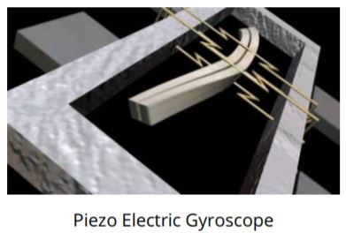
GYROSCOPE
Gyro sensors, also known as angular rate sensors or angular velocity sensors, are devices that sense angular velocity.
Gyroscopes work on the principle of Coriolis acceleration.
Imagine that there is a fork like structure, that is in constant back and forth motion. It is held in place using piezo electric crystals.
Whenever, you try to tilt this arrangement, the crystals experience a force in the direction of inclination.
This is caused as a result of the inertia of the moving fork. The crystals thus produce a current in consensus with the piezo electric effect, and this current is amplified.
The values are then refined by the host microcontroller.

Slide 32
APPLICATIONS
IMU sensors like MPU 6050 is nowadays used in most of the electronic gadgets.
These are used in smart phones to detect their orientation.
Used in wearable gadgets like Smart watches, Fit bit bands, Self Balancing robots, Quadcopters etc.
These sensors are used to determine the attitude of the object, attached with sensor in 3D space.

Slide 33
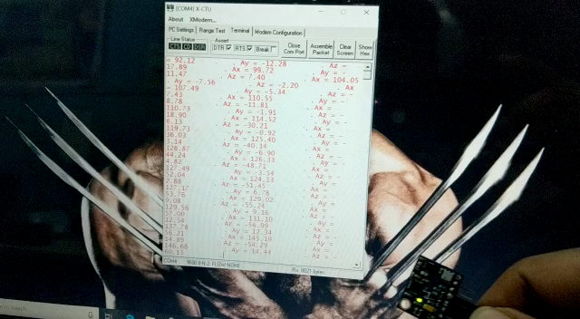

Slide 34
SERIAL PERIPHERAL interface (SPI)

Slide 35
WHAT IS SPI
A Serial peripheral interface (SPI) is an interface that enables the synchronous serial data (one bit at a time) exchange of data b/w two devices(peripheral), one called a master and the other called a slave .

Slide 36
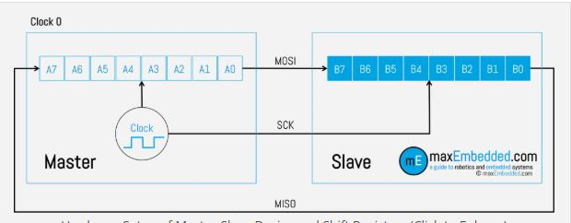
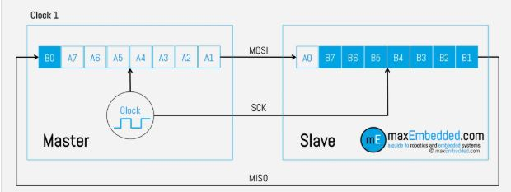
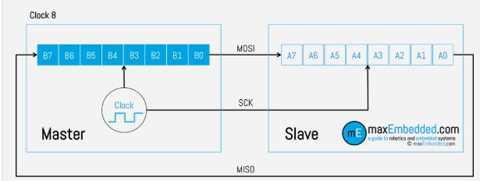

Slide 37
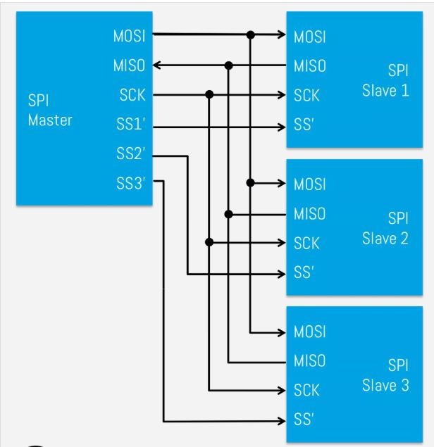
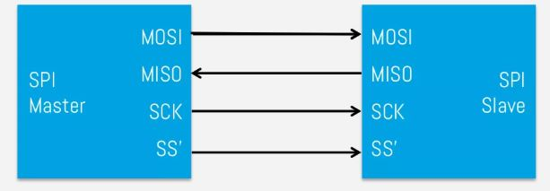
SPI Bus Interface
.

Slide 38
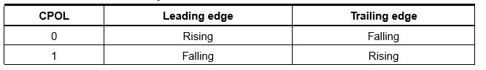
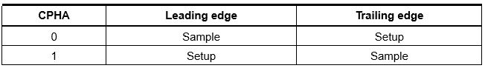
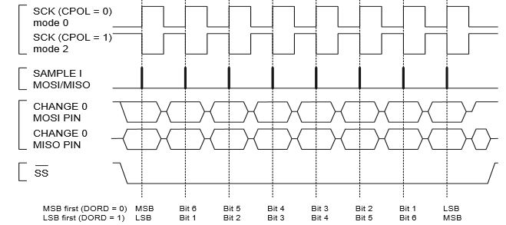
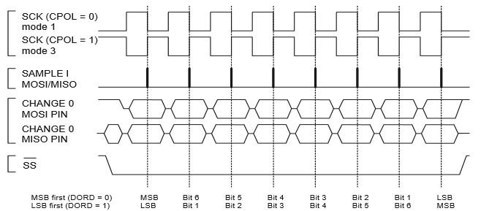
Clock Polarity and Phase
CPOL – Clock Polarity: This determines the base value
of the clock i.e. the value of the clock when SPI bus is idle.
CPHA – Clock Phase: This determines the clock transition at
which data will be sampled/captured.
When CPHA=0 i.e Sampling is done at Leading edge
When CPHA=1 i.e Sampling is done at Trailing
edge

Slide 39
TRANSMISSION
SPI and UART Interface
RECEIVING
ATmega128(Master)
START
START
Mosi
SS
Miso
SCK
Intialize Uart and Spi
Intialize Spi
ATmega128(Slave)
Recive datafrom slave(miso)/master(mosi)
SCK
SS
Mosi
Miso
Data Received?
Txd Rxd
No
yes
Data Received?
Write Data
Rxd Txd
TTL
yes
No
Error free?
Error free?
PC
XCTU
No
No
yes
yes
Transmit data to slave(mosi)/master(miso)
Read Data and Transmit by uart to TTL

Slide 40
SPI v/sI2C
SPI | I2C
In comparison to I2C, SPI is faster. | I2C is slower than SPI.
Draws less power as compared to I2C. | I2C draws more power than SPI.
There is no requirement of pull-up resistor in case of the SPI. | I2C work on wire and logic and it has a pull-up resistor.
SPI does not verify that data is received correctly or not. | I2C ensures that data sent is received by the slave device.
SPI is better for the short distance. | I2C is better for long distance.
USES:
SPI is used to talk to a variety of peripherals, such as
Sensors: temperature, pressure, ADC, touch screens, video game controllers
Control devices: audio codecs, digital potentiometers, DAC
Communications: Ethernet, USB, USART, CAN, IEEE 802.15.4, IEEE 802.11, handheld video games
Memory: flash and EEPROM
Any MMC or SD card

Slide 41
THANK YOU!

